Slide 1
InsurAI-Corporate Policy Automation and Intelligence System
MILESTONE- 4
PRESENTED BY:-
Aaisha Sultana Guduru
Manisha Mohanty
Anushka Dutta
Ananya Gupta
Firoza Sultana

Slide 2
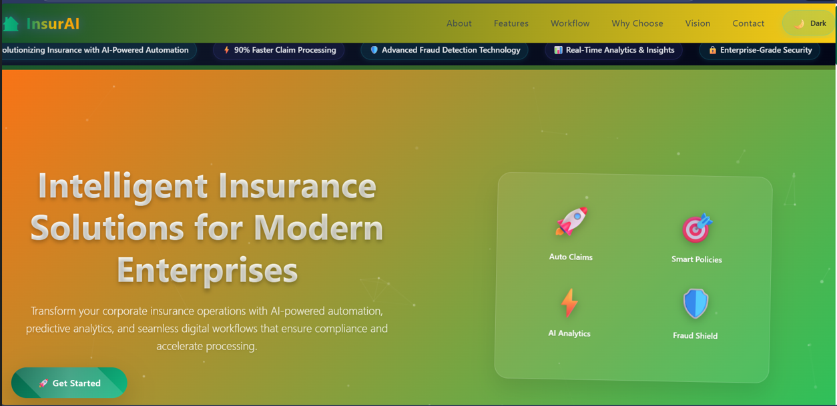
Project Overview
InsurAI is an enterprise-grade insurance management platform that streamlines and automates corporate policy workflows. It provides intelligent tools for policy administration, risk assessment, claims processing, and compliance, enabling organizations to manage insurance portfolios efficiently and insightfully.

Slide 3
KEY HIGHLIGHTS
01
02
03
04
05
Web-based application
Using React.js for frontend and Spring Boot for backend
MySQL database
For structured storage
Scalable design
For large enterprises with thousands of employees
Real-time capabilities
Provides real-time updates, automated workflows, AI-powered fraud detection, and comprehensive dashboards
Role-based access
Employee, Agent, HR Admin, and System Admin

Slide 4

PROBLEM STATEMENT
Currently, corporate insurance management suffers from manual inefficiencies:
Employees submit claims through forms or emails
HR and insurance agents manually verify policies and eligibility
Delays in claim approvals and approval errors are common
Employees cannot track claim statuses in real time
Lack of automated fraud detection results in financial losses
Administrative overhead increases operational costs
PROJECT OBJECTIVE
The system aims to simplify policy management for employees and HR, speed up claim approvals via automation, provide transparency with real-time claim tracking, reduce fraud with AI-driven anomaly detection, and generate insights and reports for HR/Admin to improve decision-making.

Slide 5

SCOPE
Focused on corporate users, not individual policyholders. Supports role-based access: Employees, Agents, HR Admin, System Admin. Core functions include policy renewals, claim approvals, tax compliance, reporting, fraud detection, analytics, and dashboards. Scalable for organizations of any size.

Slide 6
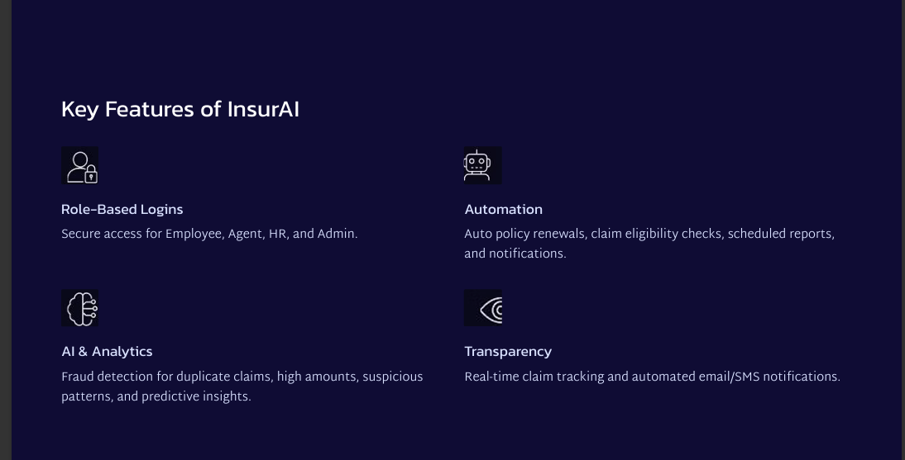

Slide 7
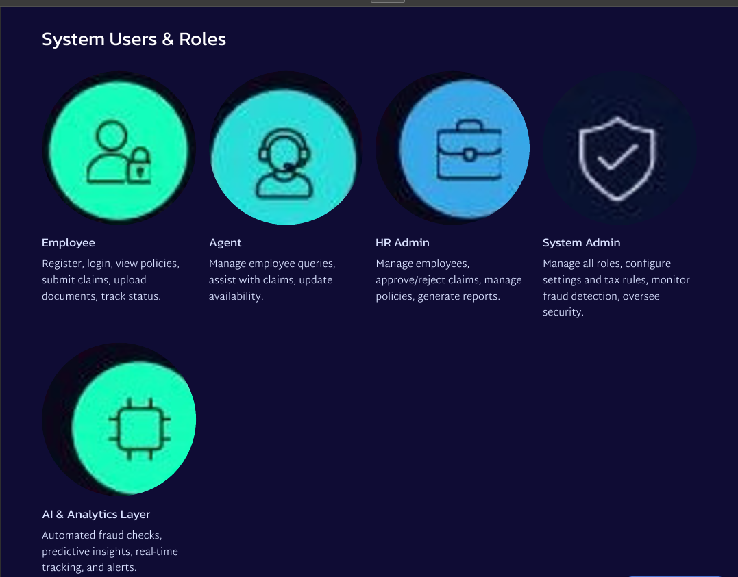
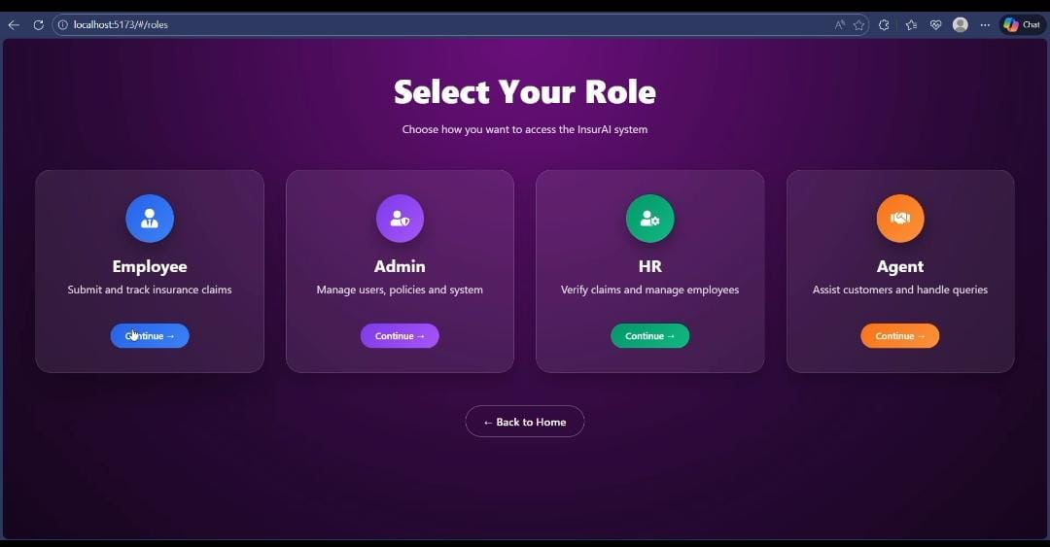
SYSTEM USERS AND ROLES

Slide 8
ADVANTAGES ,LIMITATIONS AND FUTURE SCOPE
ADVANTAGES
Employees: Faster claims, transparency, real-time updates
HR: Reduced workload, automated reporting
Admin: Full control, fraud detection, compliance
Company: Cost reduction, scalable and trusted solution
LIMITATIONS
Web-only (mobile app planned in future)
AI fraud detection initially rule-based; ML models will enhance accuracy
Integration with external insurance providers pending
Requires internet connectivity
FUTURE SCOPE
Mobile apps (Android/iOS)
For employees
Integration
With insurance companies and hospitals
Blockchain
For secure claim history
Cloud deployment
For large-scale use

Slide 9
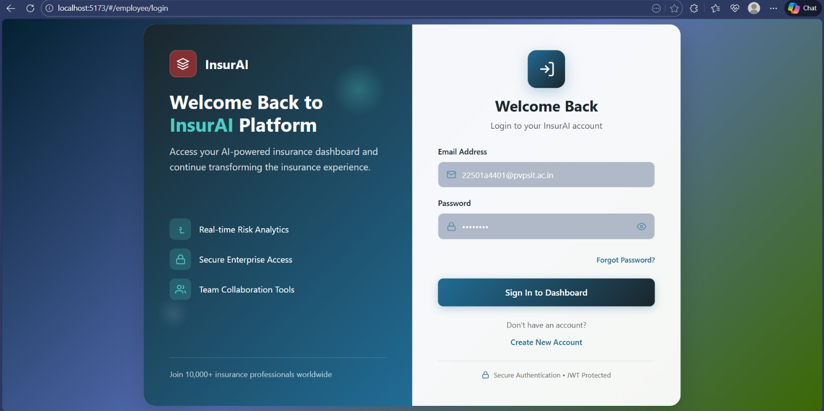
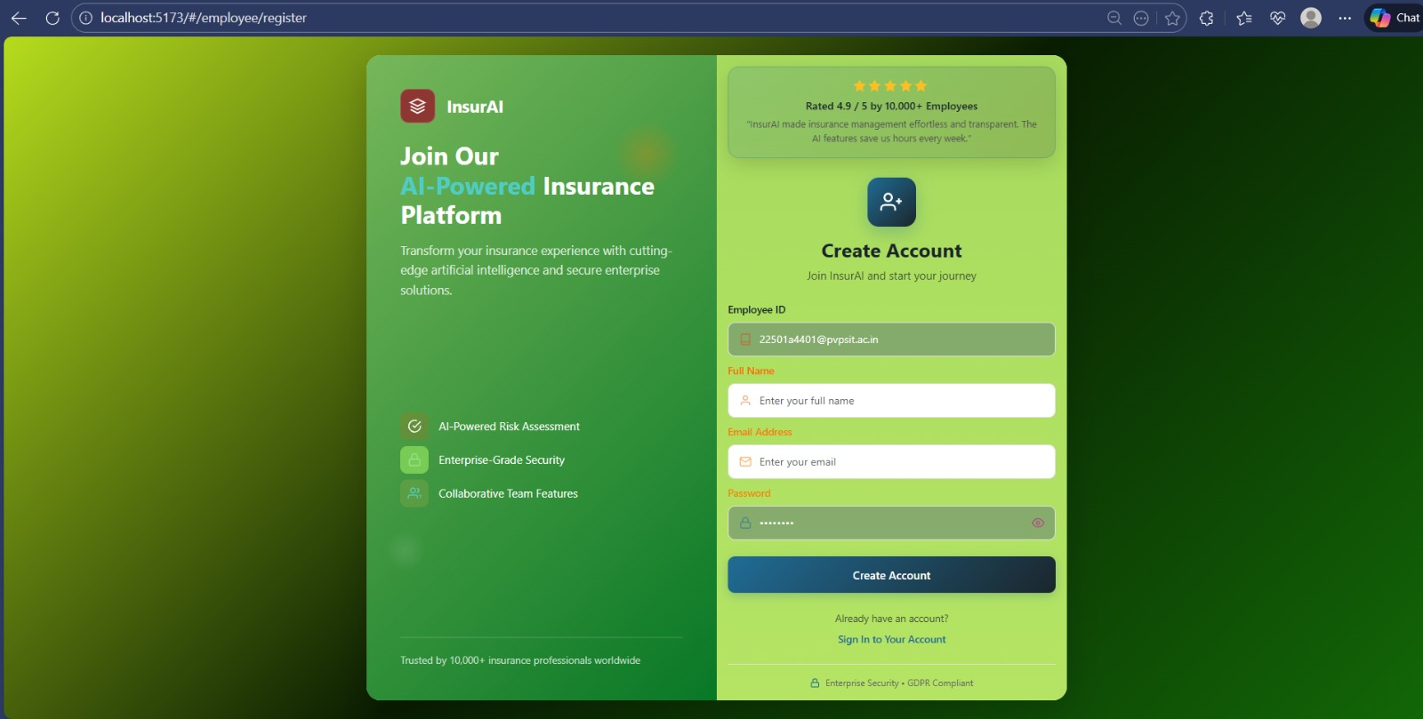
SCREENSHOTS

Slide 10
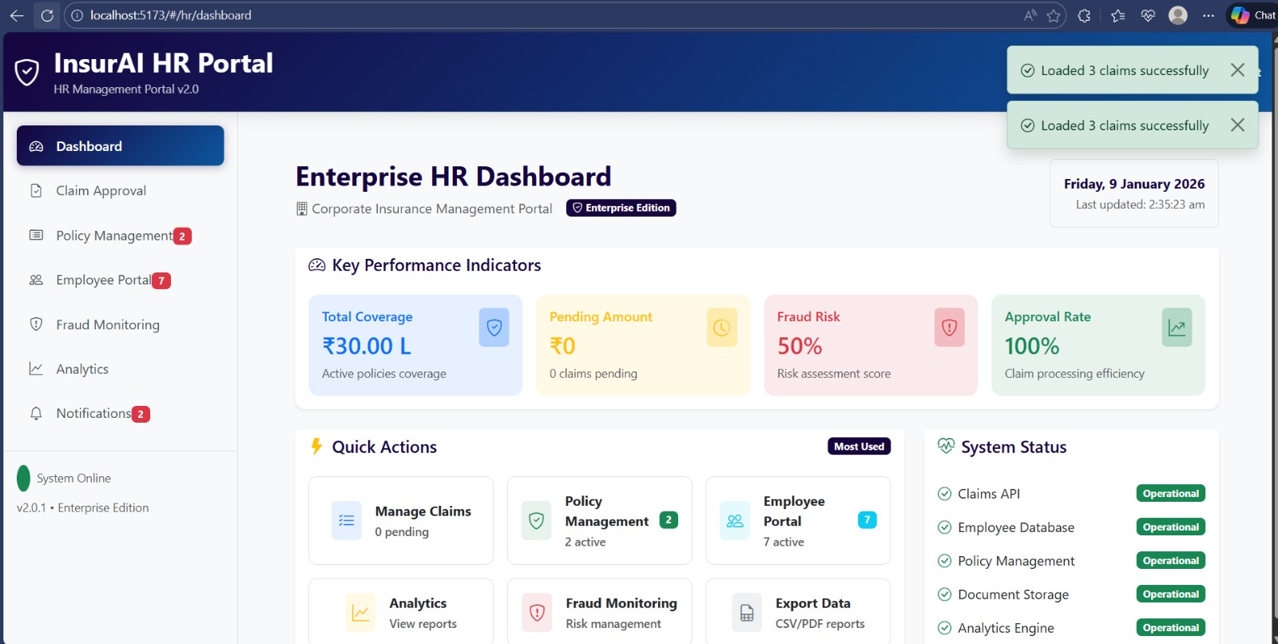
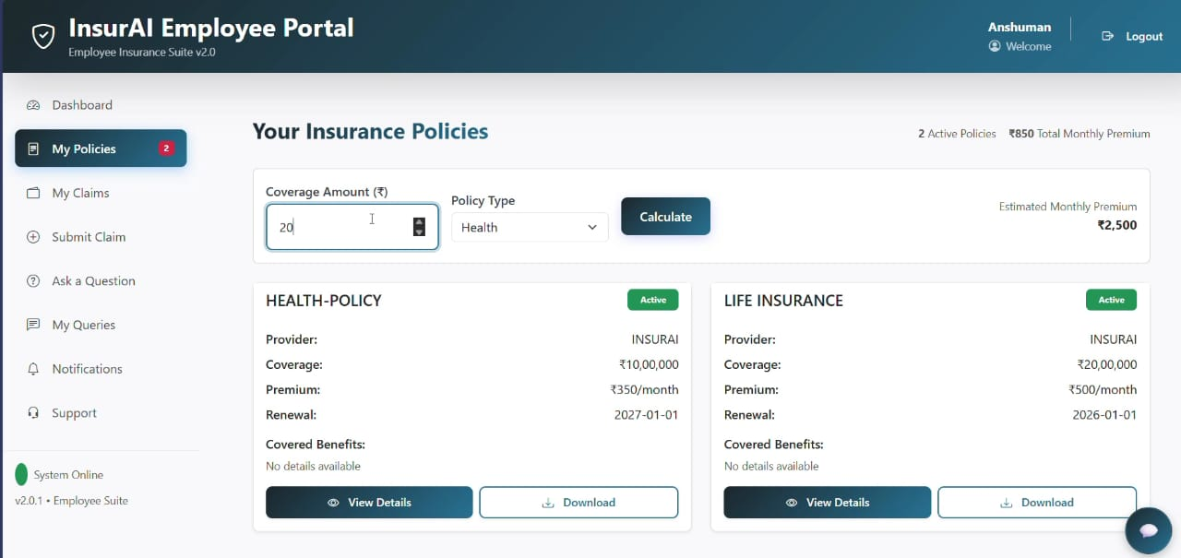
EMPLOYEE HR DASHBOARD,INSURANCE POLICIES

Slide 11
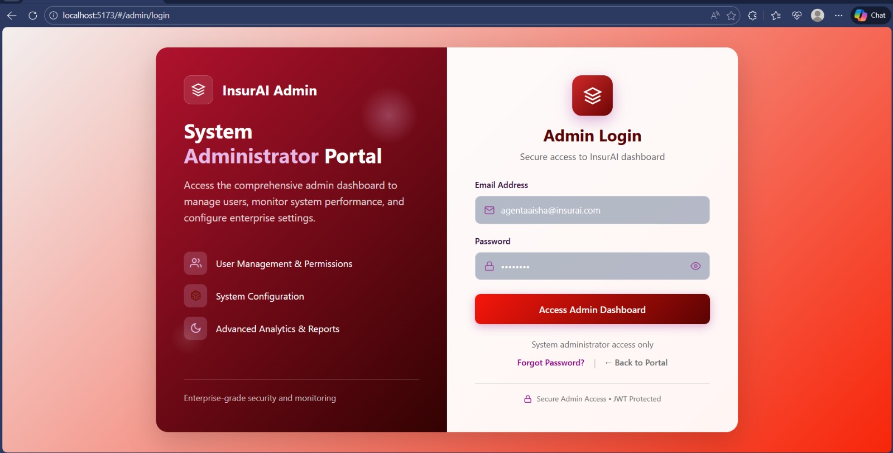
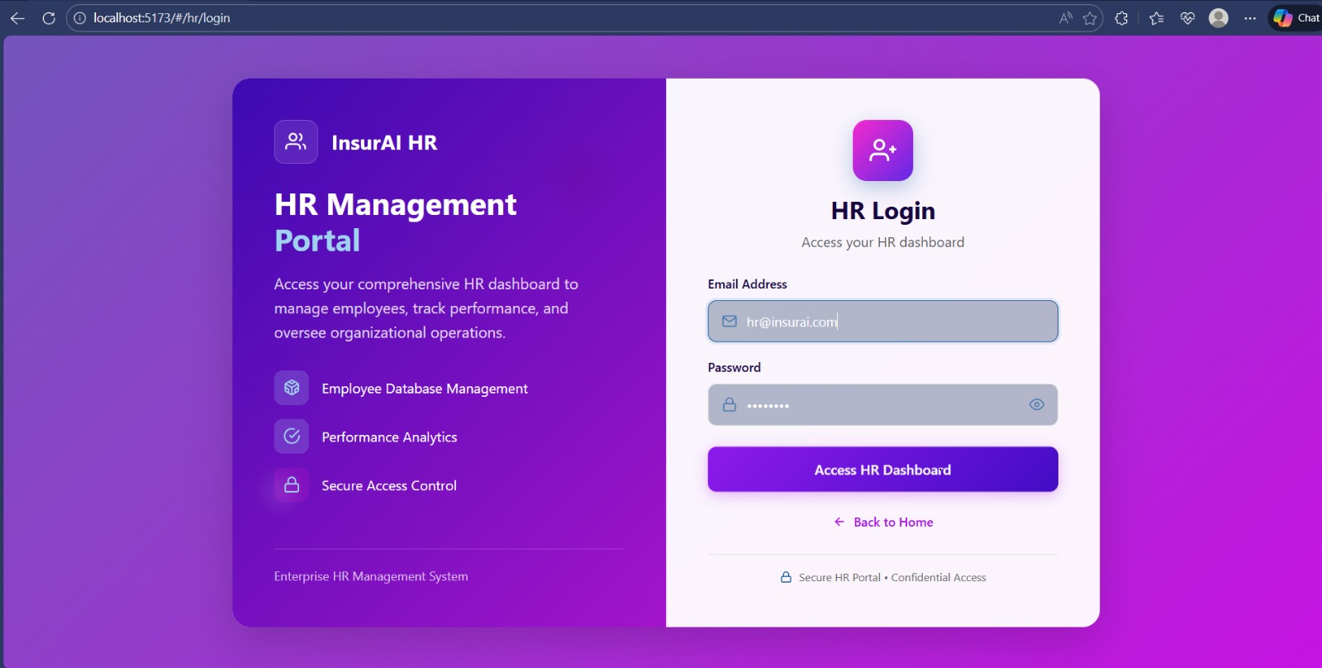
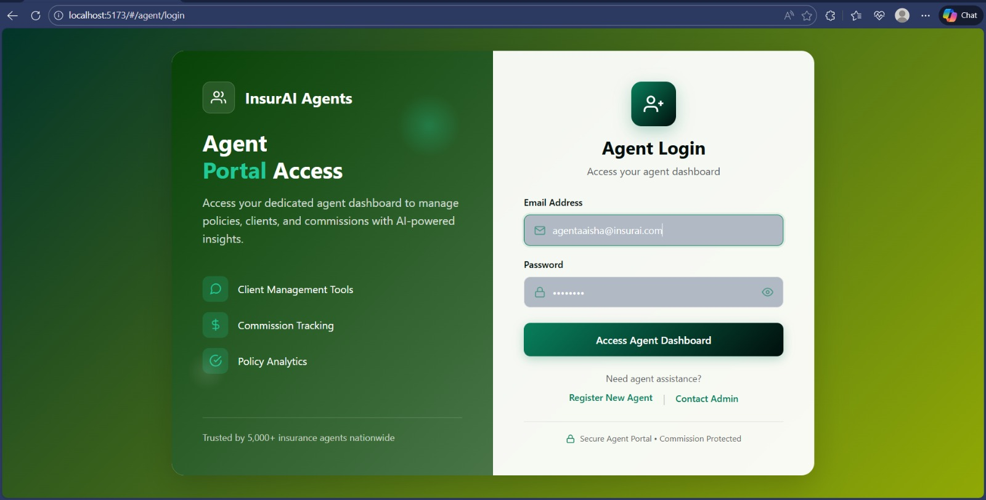
ADMIN LOGIN,AGENT LOGIN,HR LOGIN

Slide 12
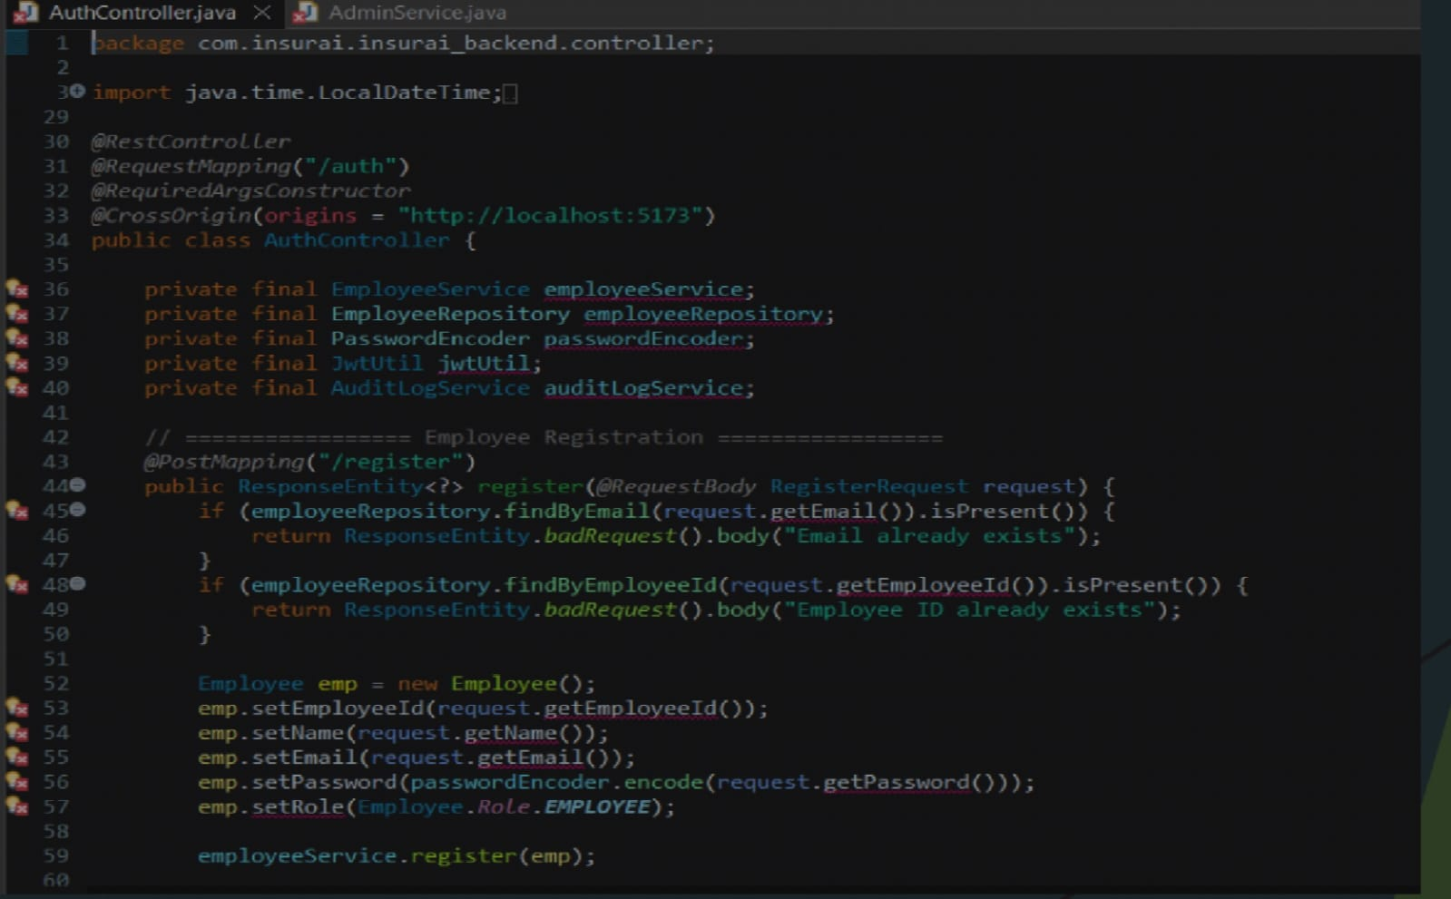
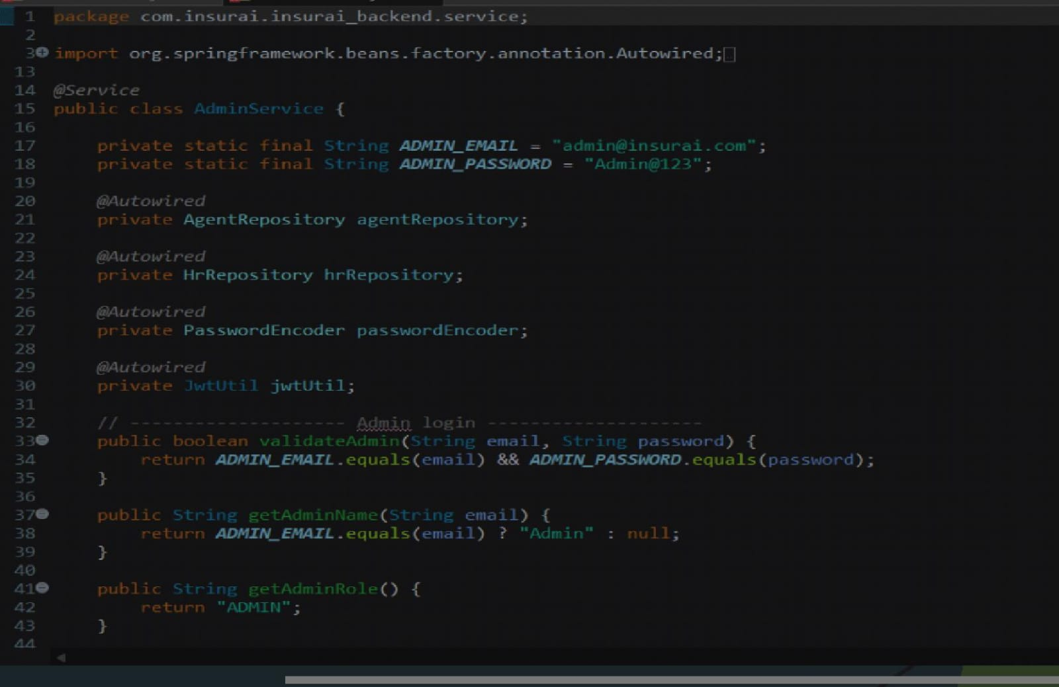
Layered Architecture Design
The backend is divided into Controller, Service, Repository, and Database layers.
Each layer has a defined responsibility and interacts only with adjacent layers, resulting in a clean and modular architecture.
Repository Layer and Database
The repository layer communicates directly with the database using Spring Data JPA. It performs CRUD operations, while the database stores role-based user data, claims, policies, and audit logs.
Controller Layer – Request Handling
The controller layer handles incoming HTTP requests from the frontend. It maps API endpoints, accepts JSON data, and forwards requests to the service layer. Controllers do not contain business logic.
Service Layer – Business Logic
The service layer contains the core business logic of the application. It validates user inputs, processes workflows such as login and claim handling, and coordinates interactions between controllers and repositories.

Slide 13
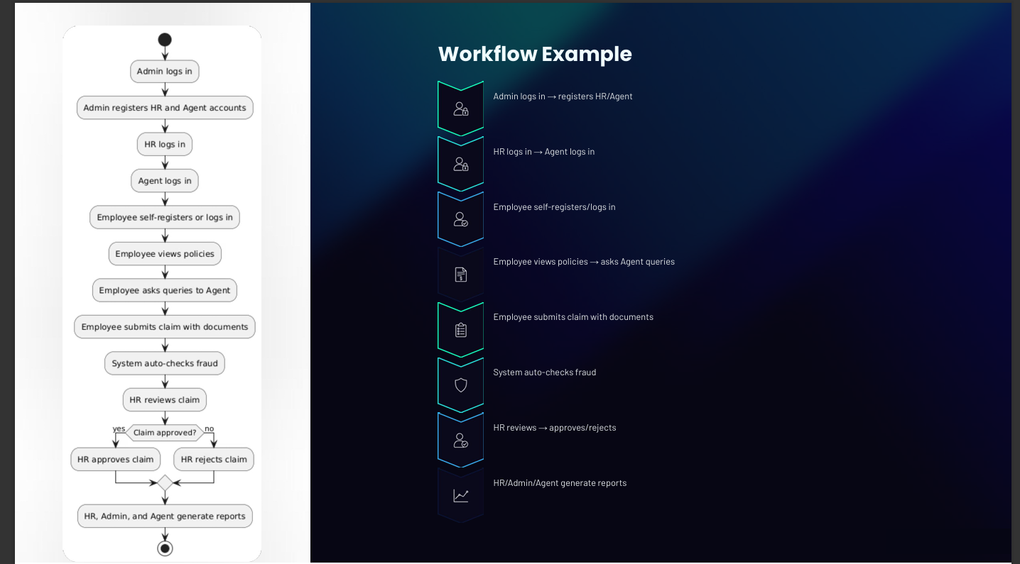

Slide 14
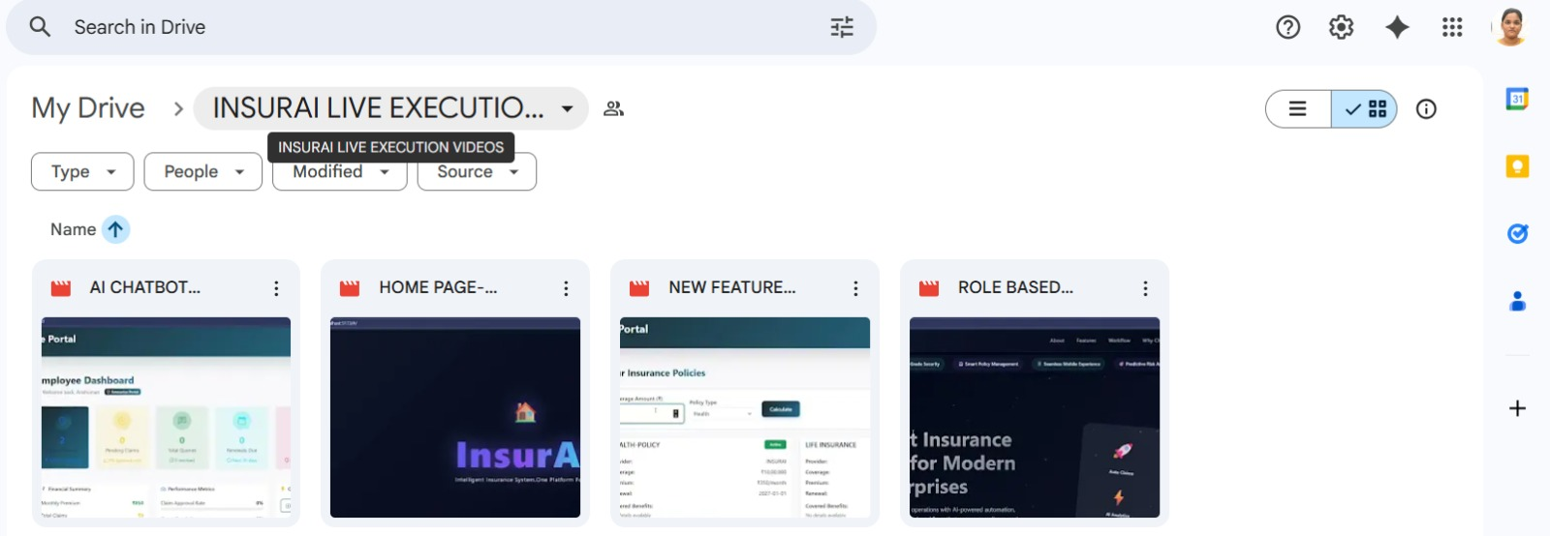
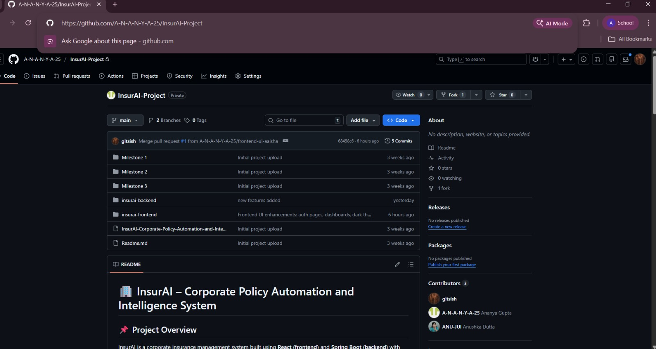
GITHUB AND GOOGLE DRIVE LINKS
DOCUMENTATION
Google Drive Link: https://drive.google.com/drive/folders/1PpRvgcAbskYgv3I545NkfslyLUSdWW0t?usp=drive_link
GitHub links: https://github.com/A-N-A-N-Y-A-25/InsurAI-Project,
https://github.com/gitsish/INFOSYS-SPRINGBOARD-INSURAI-JAVA-TECH-STACK-PROJECT

Slide 15
CONCLUSION
INSURAI EMERGES AS A COMPREHENSIVE, ENTERPRISE-GRADE SOLUTION POISED TO REVOLUTIONIZE THE INSURANCE CLAIMS PROCESS. BY LEVERAGING ADVANCED TECHNOLOGY, IT DELIVERS SUBSTANTIAL VALUE ACROSS THE ORGANIZATION:
Enhanced Efficiency: Streamlines claims management, significantly reducing workload for HR and admin staff.
Unparalleled Transparency: Offers real-time updates and clear visibility for employees, fostering trust and satisfaction.
Robust Control & Compliance: Provides administrators with full oversight, advanced fraud detection, and ensures regulatory adherence.
Strategic Growth: Delivers cost savings, scalability, and a trusted platform, supporting the company’s long-term objectives.
Future-Proofing: With planned mobile integrations, advanced AI capabilities, and blockchain security, InsurAI is designed for continuous evolution and adaptation to emerging needs.
INSURAI IS MORE THAN JUST A TOOL; IT IS A STRATEGIC PARTNER FOR BUSINESSES AIMING FOR A SMARTER, MORE SECURE, AND
EMPLOYEE-CENTRIC FUTURE IN INSURANCE CLAIMS MANAGEMENT.

Slide 16
THANK YOU!

